Slide 1

LCD Interfacing with 8051 Microcontroller

Slide 2
LCD DISPLAY
We always use devices made up of Liquid Crystal Displays (LCDs) like computers, digital watches, and also DVD and CD players. They have become very common and have taken a giant leap in the screen industry by clearly replacing the use of Cathode Ray Tubes (CRT). CRT draws more power than LCD and is also bigger and heavier. All of us have seen an LCD, but no one knows the exact working of it. Let us take a look at the working of an LCD.
Here we are using alphanumeric LCD 16×2. A 16×2 LCD display is a very basic module and is very commonly used in various devices and circuits. These modules are preferred over seven segments and other multi-segment LEDs.
The reasons are: LCDs are economical; easily programmable; have no limitation of displaying special & even custom characters (unlike in seven segments), animations, and so on.
A 16×2 LCD means it can display 16 characters per line and there are 2 such lines. In this LCD, each character is displayed in a 5×7-pixel matrix. This LCD has two registers, namely, Command and Data. The command register stores the command instructions given to the LCD. A command is an instruction given to LCD to do a predefined task like initializing it, clearing its screen, setting the cursor position, controlling the display, etc. The data register stores the data to be displayed on the LCD. The data is the ASCII value of the character to be displayed on the LCD.

Slide 3
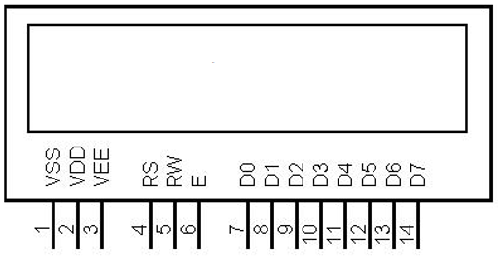
16×2 LCD Pin Diagram

Slide 4
Pin Description
Pin No. | Function | Name
1 | Ground (0V) | Ground
2 | Supply voltage; 5V (4.7V – 5.3V) | Vcc
3 | Contrast adjustment; through a variable resistor | VEE
4 | Selects command register when low; and data register when high | Register Select
5 | Low to write to the register; High to read from the register | Read/write
6 | Sends data to data pins when a high-to-low pulse is given | Enable
7 | 8-bit data pins | DB0
8 |  | DB1
9 |  | DB2
10 |  | DB3
11 |  | DB4

Slide 5
12 |  | DB5
13 |  | DB6
14 |  | DB7
15 | Backlight V_{CC} (5V) | Led+
16 | Backlight Ground (0V) | Led-
The LCD display module requires 3 control lines as well as either 4 or 8 I/O lines for the data bus. The user may select whether the LCD is to operate with a 4-bit data bus or an 8-bit data bus. If a 4-bit data bus is used the LCD will require a total of 7 data lines (3 control lines plus the 4 lines for the data bus). If an 8-bit data bus is used the LCD will require a total of 11 data lines (3 control lines plus the 8 lines for the data bus).

Slide 6
The three control lines are referred to as EN, RS, and RW.
The EN line is called “Enable.” This control line is used to tell the LCD that you are sending it data. To send data to the LCD, your program should make sure this line is low (0) and then set the other two control lines and/or put data on the data bus. When the other lines are completely ready, bring EN high (1) and wait for the minimum amount of time required by the LCD datasheet (this varies from LCD to LCD), and end by bringing it low (0) again.
The RS line is the “Register Select” line. When RS is low (0), the data is to be treated as a
command or special instruction (such as a clear screen, position cursor, etc.). When RS is high (1), the data being sent is text data which should be displayed on the screen. For example, to display the letter “T” on the screen you would set RS high.
The RW line is the “Read/Write” control line. When RW is low (0), the information on the data
bus is written to the LCD. When RW is high (1), the program is effectively querying (or reading) the LCD. Only one instruction (“Get LCD status”) is a read command. All others are write commands–so RW will almost always be LOW.

Slide 7
Finally, the data bus consists of 4 or 8 lines (depending on the mode of operation selected by the user). In the case of an 8-bit data bus, the lines are referred to as DB0, DB1, DB2, DB3, DB4, DB5, DB6, and DB7.

Slide 8
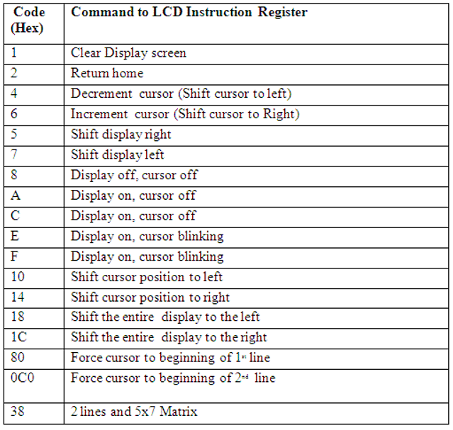
LCD COMMANDS

Slide 9
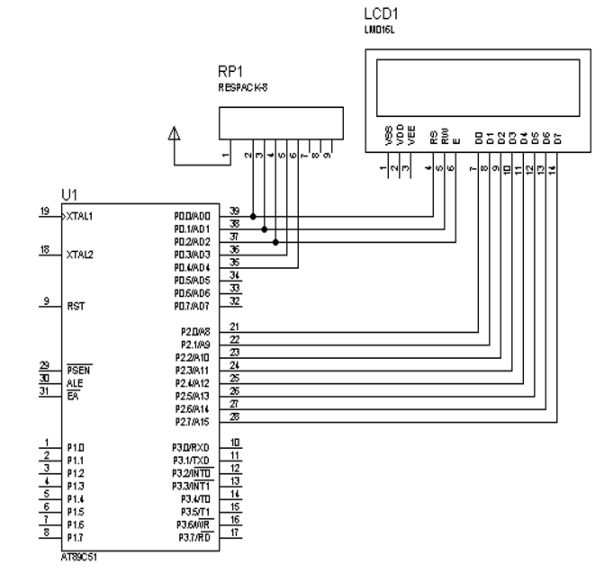
Interfacing LCD with Microcontroller – CIRCUIT DIAGRAM

Slide 10
RS is connected to Port 0.0 (P0.0) RW is connected to Port 0.1 (P0.1) EN is connected to Port 0.2 (P0.2) Data lines are connected to Port 2 (P2)
LCD Interfacing with 8051 Microcontroller – Programming
Send Data
To send data on the LCD, data is first written to the data pins with R/W = 0 (to specify the write
operation) and RS = 1 (to select the data register). A high to low pulse is given at EN pin when data is sent. Each write operation is performed on the positive edge of the Enable signal.
void dat(unsigned char b)
{
lcd_data=b;
rs=1; rw=0;
en=1;
lcd_delay(); en=0;
}

Slide 11
Send String
We cannot send more than 8 bits at the same time. Because data lines are only having 8 bits. So how we can send string? Any guess? Yeah, you are correct. We have to send the string by character. See this code.
void show(unsigned char *s)
{
while(*s) {
dat(*s++);
}
}

Slide 12
Send Command
To send a command on the LCD, a particular command is first specified to the data pins with
R/W = 0 (to specify the write operation) and RS = 0 (to select the command register). A high to low pulse is given at the EN pin when data is sent.
void cmd(unsigned char a)
{
lcd_data=a;
rs=0;
rw=0;
en=1;
lcd_delay();
en=0;
}

Slide 13
LCD Initializing
To initialize the LCD, we have to use certain commands.
void lcd_init()
{
cmd(0x38);
cmd(0x0e);
cmd(0x01);
cmd(0x06);
cmd(0x0c);
cmd(0x80);
}

Slide 14
LCD Interfacing with 8051 – FULL CODE
#include <reg51.h>
#define lcd_data P2
sbit rs=P0^0;
sbit rw=P0^1;
sbit en=P0^2;
void lcd_init();
void cmd(unsigned char a);
void dat(unsigned char b);
void show(unsigned char *s);
void lcd_delay();
void lcd_init()
{
cmd(0x38); cmd(0x0e);
cmd(0x01); cmd(0x06);
cmd(0x0c); cmd(0x80);
}

Slide 15
void cmd(unsigned char a)
{
lcd_data=a;
rs=0; rw=0;
en=1;
lcd_delay();
en=0;
}
void dat(unsigned char b)
{
lcd_data=b;
rs=1; rw=0;
en=1;
lcd_delay(); en=0;
}

Slide 16
void show(unsigned char *s)
{
while(*s) {
dat(*s++);
}
}
void lcd_delay()
{
unsigned int lcd_delay;
for(lcd_delay=0;lcd_delay<=6000;lcd_delay++);
}

Slide 17
int main()
{
unsigned int j;
lcd_init();
while(1) {
cmd(0x80);
show(" Welcome To ");
cmd(0xc0);
show(" EMBETRONICX.COM");
for(j=0; j<30000; j++);
cmd(0x01);
for(j=0; j<30000; j++);
}
}

Slide 18
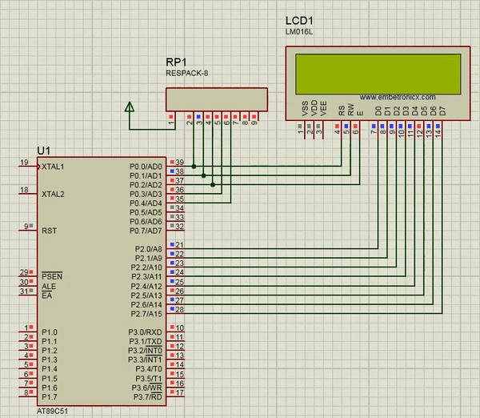
LCD Interfacing with 8051 – Working

Slide 19
TEXTBOOKS/REFERENCE BOOKS
  TEXTBOOKS
T1 Kenneth Ayala, The 8051 Microcontroller, Cengage Learning India, 3rd Edition, Nov 2007
T2 B. Kanta Rao, Embedded Systems, PHI, 1st Edition, January 2011
T3 John Boxall, Arduino Workshop: A Hands-On Introduction with 65 Projects, No Starch Press, 1st Edition, May 2013
  REFERENCE BOOKS
R1 B. Ram, Fundamentals of Microprocessors and Microcontrollers, DRP, 8th Edition, Nov 2021
R2 Massimo Banzi, Getting Started with Arduino, Make Community LLC, 3rd Edition, Jan 2015
R3 Jeremy Blum, Exploring Arduino: Tools and Techniques for Engineering Wizardry, Wiley, 1st Edition, Aug 2013
Video Links:
https://www.youtube.com/watch?v=PDnPSiblELg
https://www.youtube.com/watch?v=pihAdSek7oM
https://youtu.be/aJYrjSLdAyg?si=XoIglSllQ3AQvFGd

